Slide 1
Quasi-Newton Methods of Optimization
Lecture 2

Slide 2
General Algorithm
A Baseline Scenario
  Algorithm U (Model algorithm for n-dimensional unconstrained minimization). Let x_{k} be the current estimate of x*.
    U1. [Test for convergence] If the conditions for convergence are satisfied, the algorithm terminates with x_{k} as the solution.
    U2. [Compute a search direction] Compute a non-zero n-vector p_{k}, the direction of the search.

Slide 3
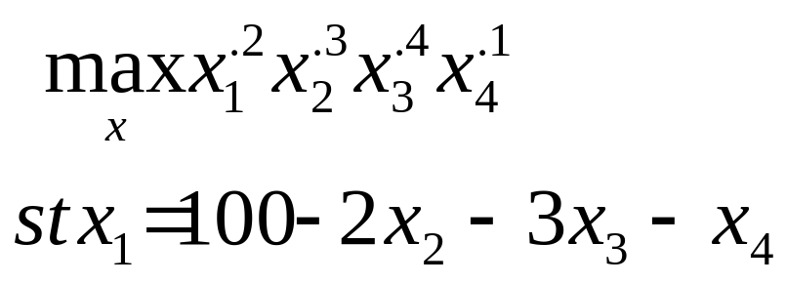
General Algorithm
    U3. [Compute a step length] Compute a scalar a_{k}, the step length, for which f(x_{k} + a_{k}p_{k} )<f(x_{k}).
    U4. [Update the estimate of the minimum] Set x_{k+1} = x_{k} + a_{k} p_{k}, k=k+1, and go back to step U1.
  Given the steps to the prototype algorithm, I want to develop a sample problem that we can compare the various algorithms against.

Slide 4
General Algorithm
    Using Newton-Raphson, the optimal point for this problem is found in 10 iterations using 1.23 seconds on the DEC Alpha.

Slide 5
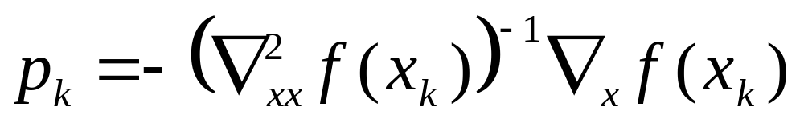
Derivation of the Quasi-Newton Algorithm
An Overview of Newton and Quasi-Newton Algorithms
  The Newton-Raphson methodology can be used in U2 in the prototype algorithm. Specifically, the search direction can be determined by:

Slide 6
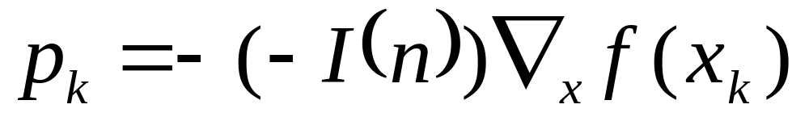
Derivation of the Quasi-Newton Algorithm
  Quasi-Newton algorithms involve an approximation to the Hessian matrix. For example, we could replace the Hessian matrix with the negative of the identity matrix for the maximization problem. In this case the search direction would be:

Slide 7
Derivation of the Quasi-Newton Algorithm
  This replacement is referred to as the steepest descent method. In our sample problem, this methodology requires 990 iterations and 29.28 seconds on the DEC Alpha.
    The steepest descent method requires more overall iterations. In this example, the steepest descent method requires 99 times as many iterations as the Newton-Raphson method.

Slide 8
Derivation of the Quasi-Newton Algorithm
    Typically, the time spent on each iteration is reduced. Again, in the current comparison each the steepest descent method requires .123 seconds per iteration while Newton-Raphson requires .030 seconds per iteration.

Slide 9
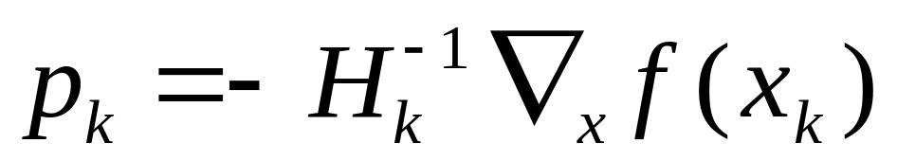
Derivation of the Quasi-Newton Algorithm
  Obviously substituting the identity matrix uses no real information from the Hessian matrix. An alternative to this drastic reduction would be to systematically derive a matrix H_{k} which uses curvature information akin to the Hessian matrix. The projection could then be derived as:

Slide 10
Derivation of the Quasi-Newton Algorithm
Conjugate Gradient Methods
  One class of Quasi-Newton methods are the conjugate gradient methods which “build” up information on the Hessian matrix.
    From our standard starting point, we take a Taylor series expansion around the point
    x_{k} + s_{k}

Slide 11
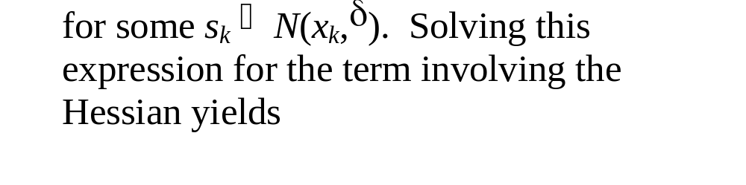
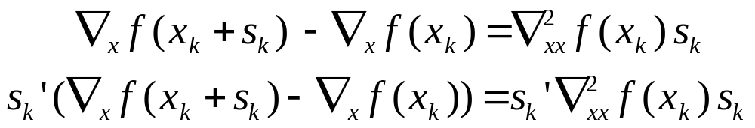
Derivation of the Quasi-Newton Algorithm

Slide 12
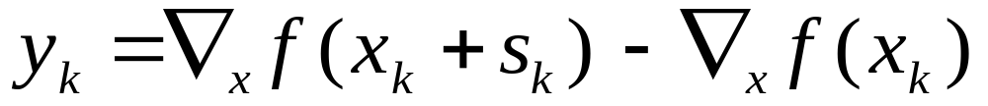
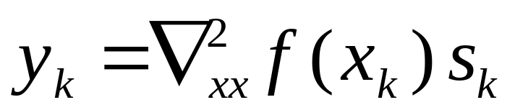
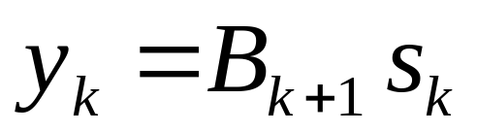
Derivation of the Quasi-Newton Algorithm

Slide 13
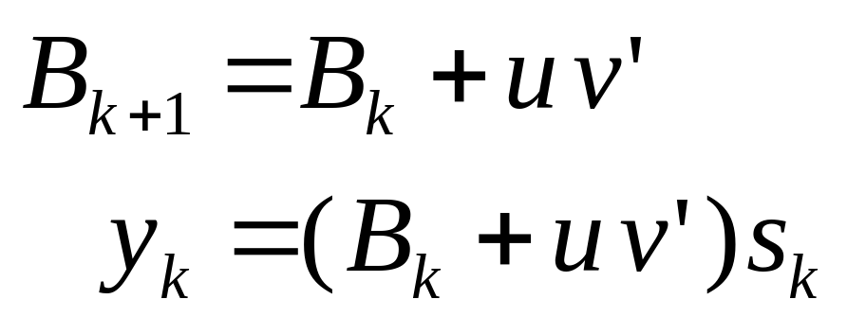
Derivation of the Quasi-Newton Algorithm
One way to generate B_{k+1} is to start with the current B_{k} and add new information on the current solution

Slide 14
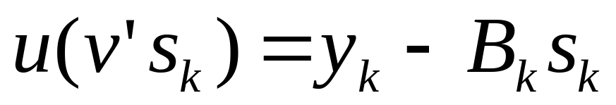
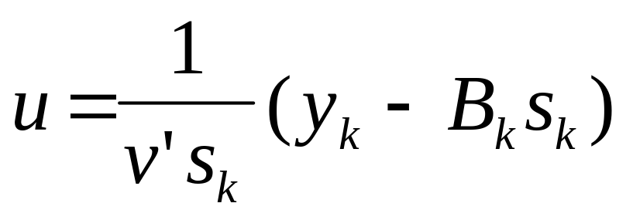
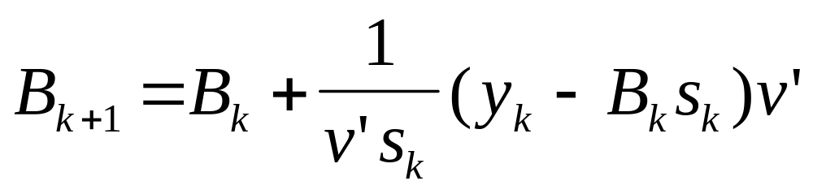
Derivation of the Quasi-Newton Algorithm

Slide 15
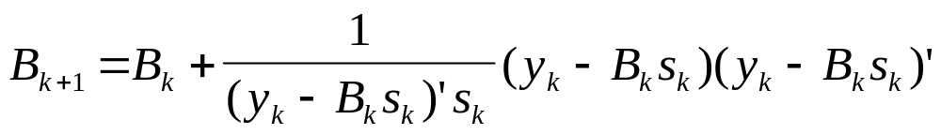
Derivation of the Quasi-Newton Algorithm
  The Rank-One update then involves choosing v to be y_{k} + B_{k}s_{k}. Among other things, this update will yield a symmetric Hessian matrix:

Slide 16
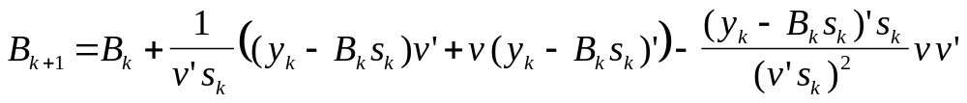
Derivation of the Quasi-Newton Algorithm
  Other than the Rank-One update, no simple vector will result in a symmetric Hessian. An alternative is to reconfigure the Hessian by letting the numeric be the 1/2 the sum of a numeric approximation plus itself transposed. This procedure yields the general update:

Slide 17
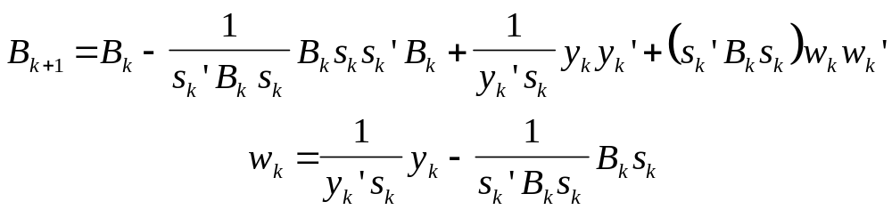
DFP and BFGS
  Two prominent conjugate gradient methods are the Davidon-Fletcher-Powell (DFP) update and the Broyden-Fletcher-Goldfarb-Shanno (BFGS) update.
    In the DFP update v is set equal to y_{k} yielding

Slide 18
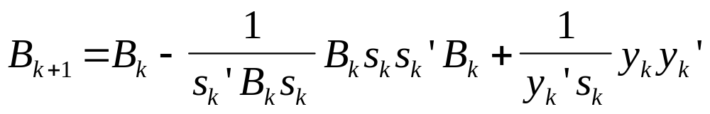
DFP and BFGS
    The BFGS update is then

Slide 19
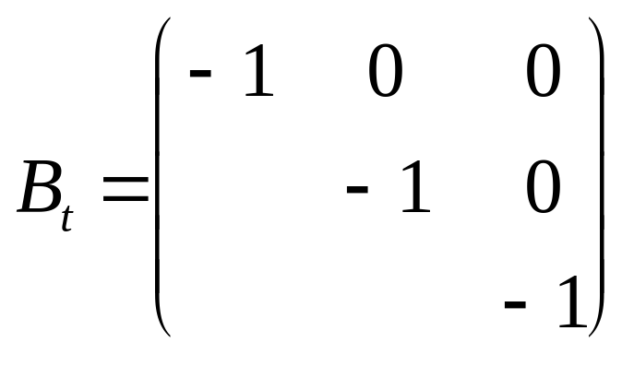
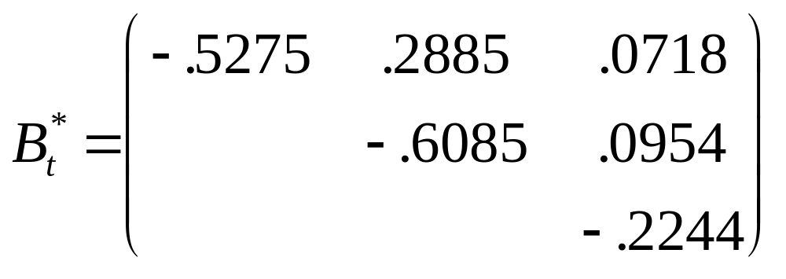
DFP and BFGS
A Numerical Example
  Using the previously specified problem and starting with an identity matrix as the original Hessian matrix, each algorithm was used to maximize the utility function.

Slide 20
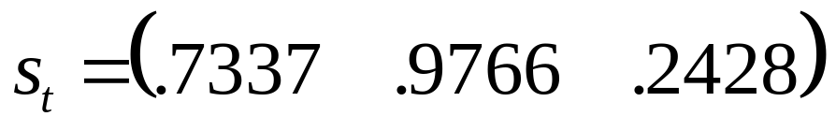
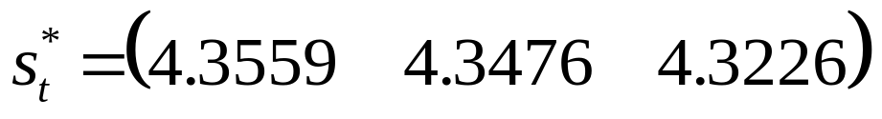
DFP and BFGS
  In discussing the difference in step, I will focus on two attributes.
    The first attribute is the relative length of the step (the 2-norm).
    The second attribute is the direction of the step. Dividing each vector by its 2-norm yields yields a normalized direction of the search

Slide 21
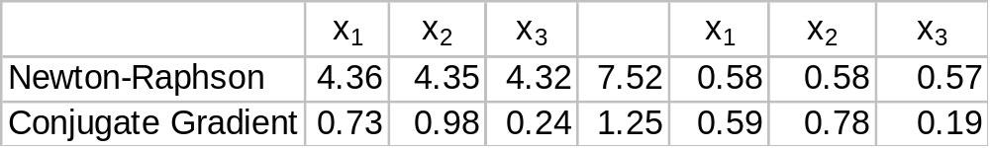
DFP and BFGS

Slide 22
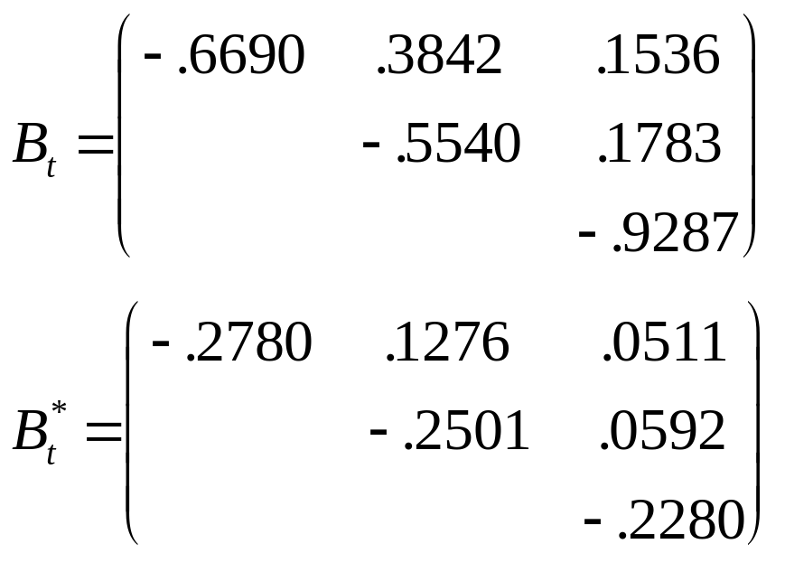
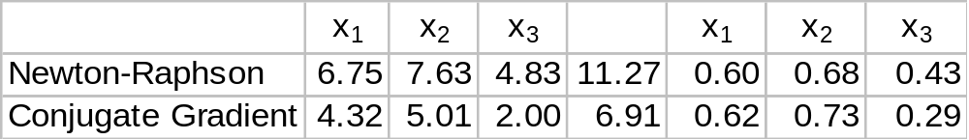
Relative Performance
    The Rank One Approximation
      Iteration 1

Slide 23
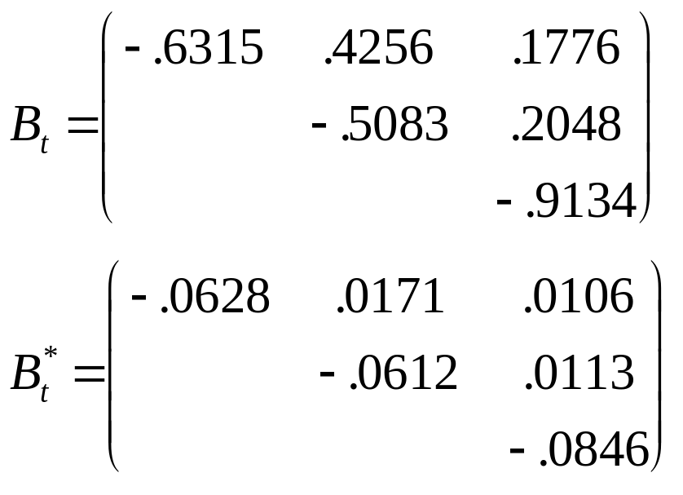
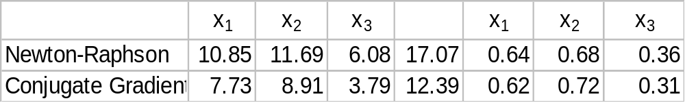
Relative Performance
      Iteration 2

Slide 24
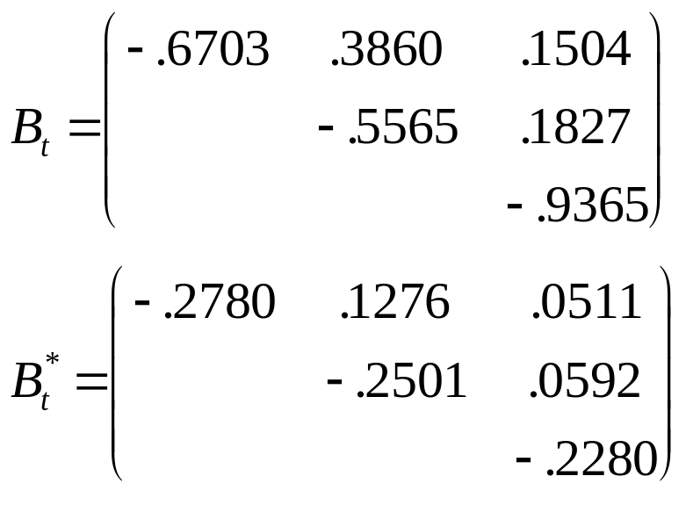
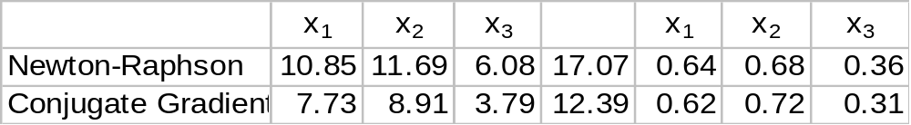
Relative Performance
    PSB
      Iteration 1

Slide 25
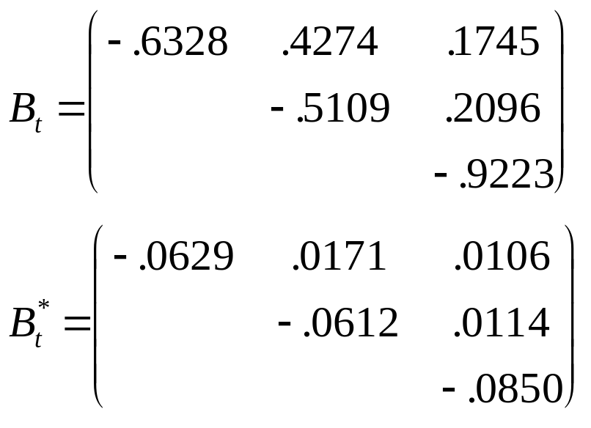
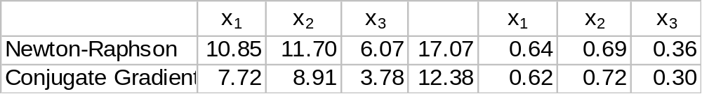
Relative Performance
      Iteration 2

Slide 26
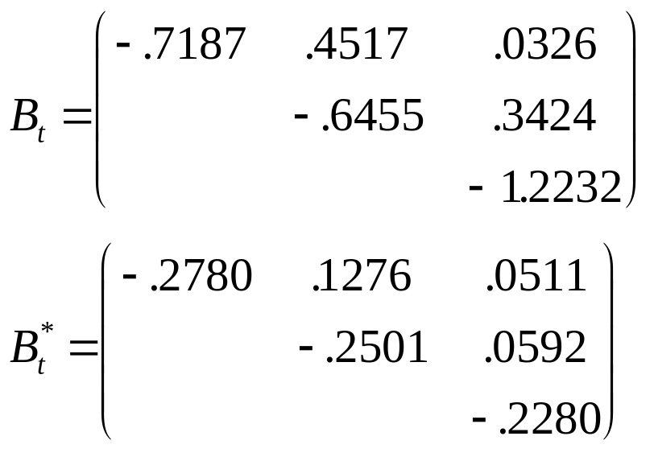
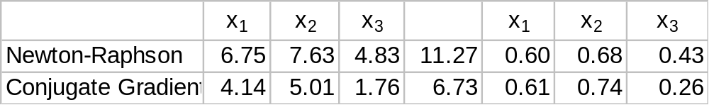
Relative Performance
    DFP
      Iteration 1

Slide 27
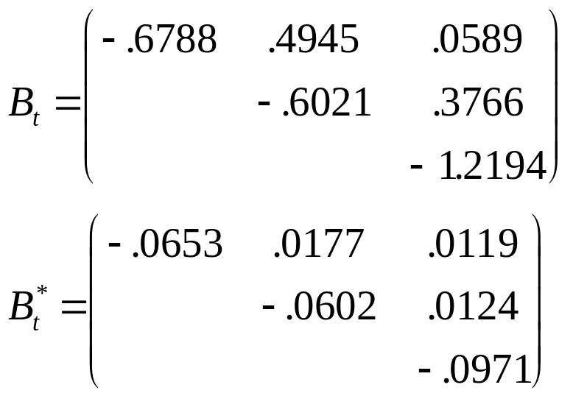
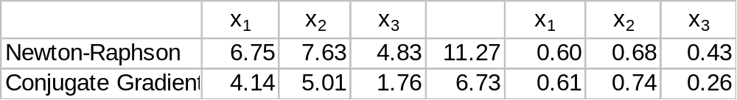
Relative Performance
      Iteration 2

Slide 28
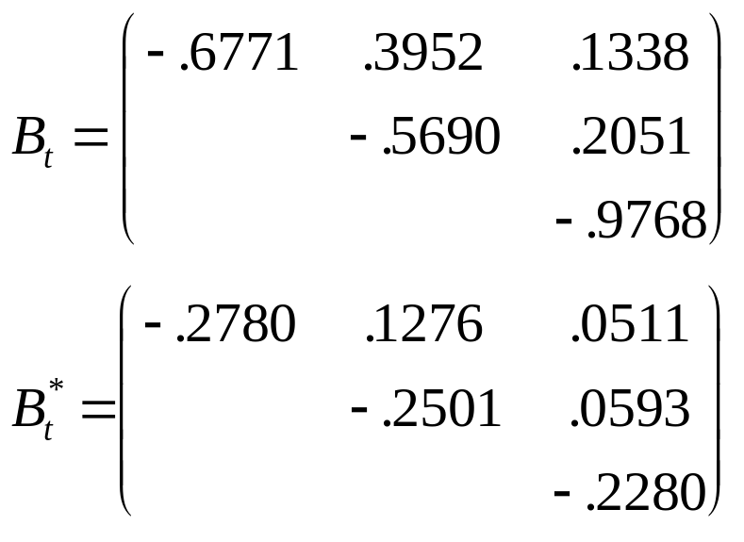
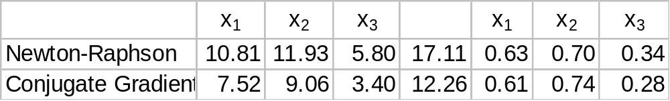
Relative Performance
    BFGS
      Iteration 1

Slide 29
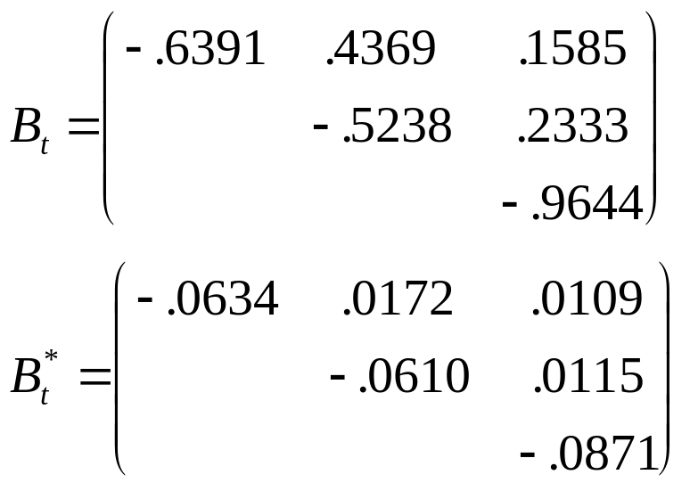
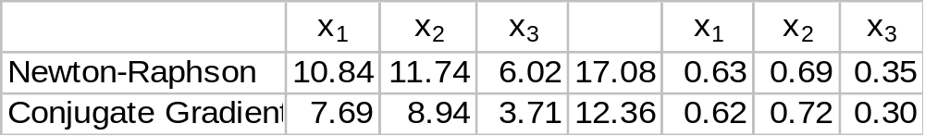
Relative Performance
      Iteration 2

